Slide 1

CompSci 3SH3
Lab #3
TA: Jatin Chowdhary
DATE: January 28th, 2022

Slide 2
Introduction
Question: Assume you want to download a big file, like 100GB, through your web browser. When you click download what happens? Are you allowed to continue using the web browser, or does it deny access until the download has completed?
Answer:
  Next slide

Slide 3
Introduction
Question: Assume you want to download a big file, like 100GB, through your web browser. When you click download what happens? Are you allowed to continue using the web browser, or does it deny access until the download has completed?
Answer:
  Put simply, upon clicking ‘‘Download’’, the web browser initiates a connection and the file starts downloading in the background. Meanwhile, the user can continue surfing the web, watch cat videos, read the news, check their emails, etc. The download does not interfere with the user’s ability to browse the web.
    But wait, how is this possible; doing multiple things at once?!?

Slide 4
Introduction
Question: Behind the scenes, what do you think the browser is doing? For instance, anytime you download a file, create a new tab, or enable private browsing. Does your web browser only allow you to do one thing at a time?
Answer:
  Next slide

Slide 5
Introduction
Question: Behind the scenes, what do you think the browser is doing? For instance, anytime you download a file, create a new tab, or enable private browsing. Does your web browser only allow you to do one thing at a time?
Answer:
  Of course not. Modern web browsers enable users to browse multiple sites at the same time, download dozens of files/documents simultaneously, and consume content in the background.
    Once again, how is this possible?

Slide 6
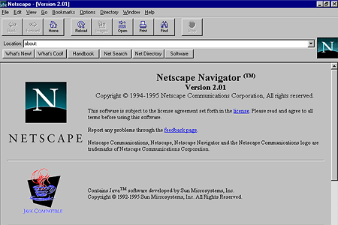
Introduction
Before the main question can be answered, take a look at the following:
Question: What is this?
Answer: One of the earliest web browsers; called Netscape. Early web browsers like NetScape did support multiple tabs, downloading files in the background, etc.

Slide 7
Introduction
So the question we have to ask is, ‘‘What has changed in the past few years?’’ Why was Netscape limited to one window/tab, while the latest version of Chrome can open dozens of tabs and browse dozens of different sites, at the same time?
  The simple answer is processes and threads. Processes and threads allow modern web browsers (and computing systems as a whole) to have multiple windows open at the same time with full functionality.
    i.e. Open different PDFs at the same time
    i.e. Work on multiple MS-Word documents at the same time

